Slide 1
Tess
(GPE-funded BESDA-AF Project)
Implementation SUPPORT MISSION
Ibadan, Oyo State- Nigeria
March 25-29, 2024

Slide 2
Katsina State
Progress Report on
Results Area 1
TESS Mission - Ibadan, Oyo State- Nigeria
March 25-29, 2024

Slide 3
State consultant and sbmc training reports
Technical Assistant engaged to support (RA1) Infrastructure & System Strengthening for TESS Project in Katsina State
SBMC Training reports:
Indicator | Response
No. of SBMCs trained overall | 640 (Male-466; Female-174)
No. of SBMCs trained by LGA | 150
Number of students covered in the schools where the SBMCs had been trained | 89,567 (Boys – 45,833 and Girls – 43,734)
SBMCs Training reports prepared | Yes:

Slide 4
School development plans
Intermediate outcomes following the SBMC trainings so far:
Town hall meeting by SBMCs at community level of the TESS project/SIG implementation modalities
Identification of school priority need
Development of SIP and costing
Constituting of sub-committees for project implementation and monitoring
Status of School Development Plans (SDPs)
Activity | Number
No. of SDPs received | 150
No of SDPs reviewed and approved | 150
No. of SDPs ready for implementation | 150
No. of MOUs signed | 150

Slide 5
School development plans
Challenges on SDPs:
Some schools’ sub-projects can not be covered due to budget constraint
Some school needs can not be address due to fear of vandalization
Cost Inflation of goods/materials

Slide 6
Status of site screening reports
Status of site screening reports for selected intervention schools.
Indicator | Response
Has intervention schools under the project been selected? | Yes (240 – School Network Package)
Has site screening for selected intervention schools commenced | Yes, completed
No. of schools visited for site screening | 150 Schools screened
No. of site screening report prepared | 1 comprehensive report covering 150 sites

Slide 7
Status of site screening reports
Program for Results work plan: Developed and cleared
Project Advance Implementation Plan: Developed, cleared and under implementation
Has the first disbursement to the SBMCs made? Yes
Number of schools/SBMCs planned to be included in the different phases.
Phases | No. of schools
First Phase | 150
Second Phase | 90
Third Phase | -

Slide 8
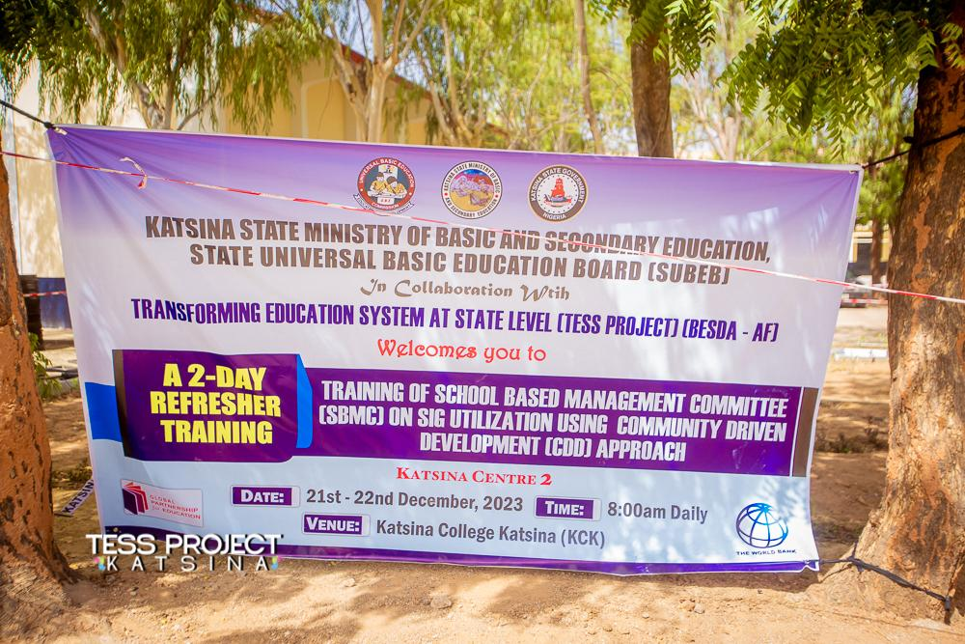
Pictorial evidence of SBMC Training

Slide 9
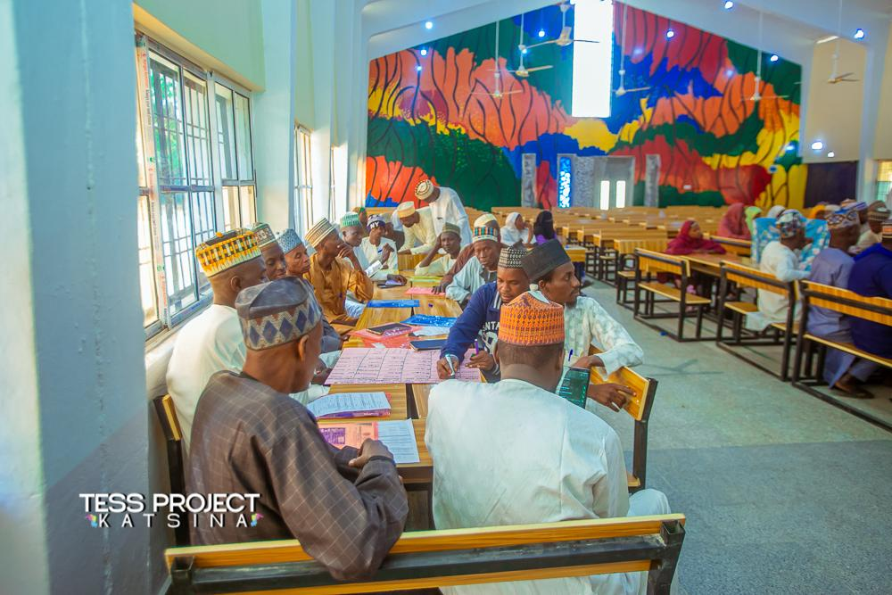
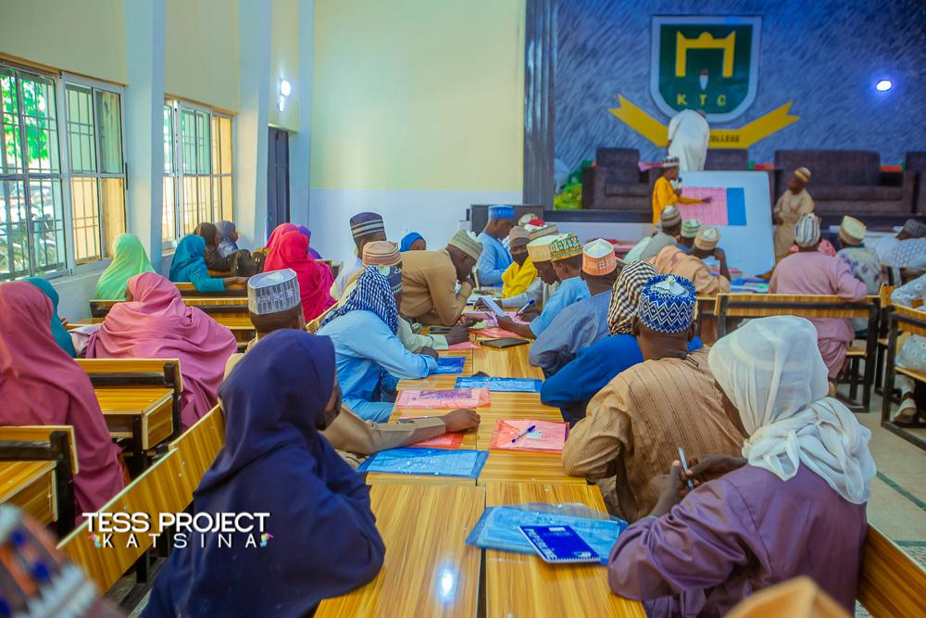
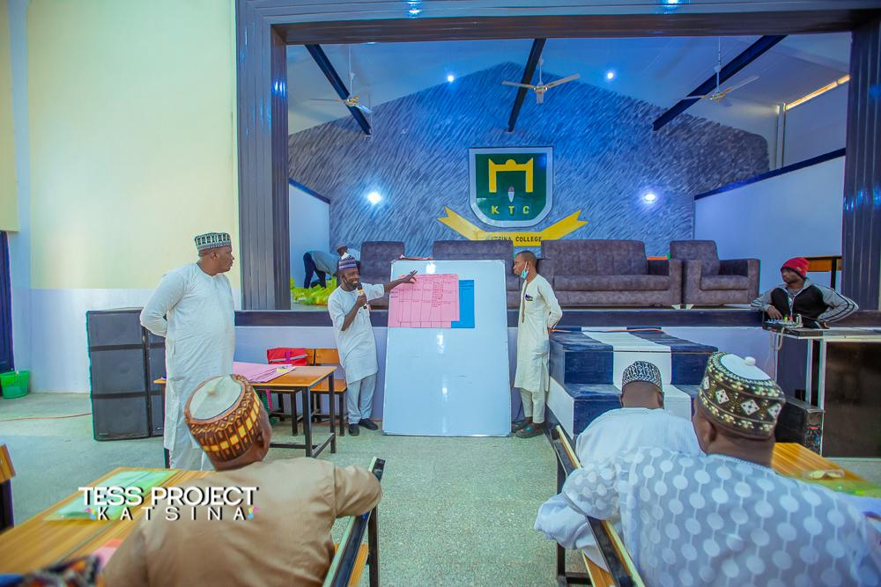
Pictorial evidence of SBMC Training

Slide 10
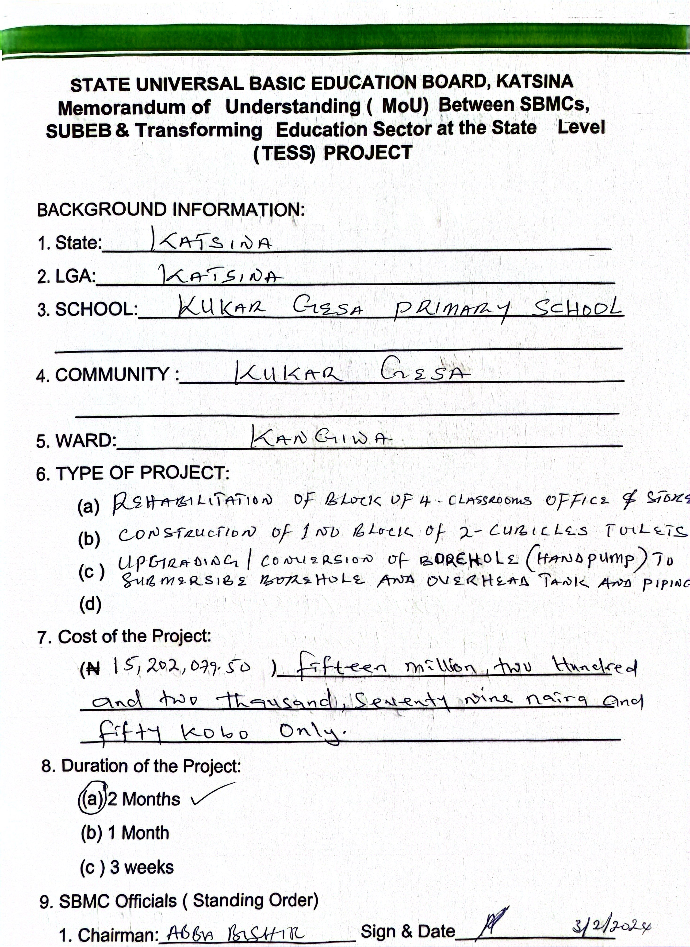
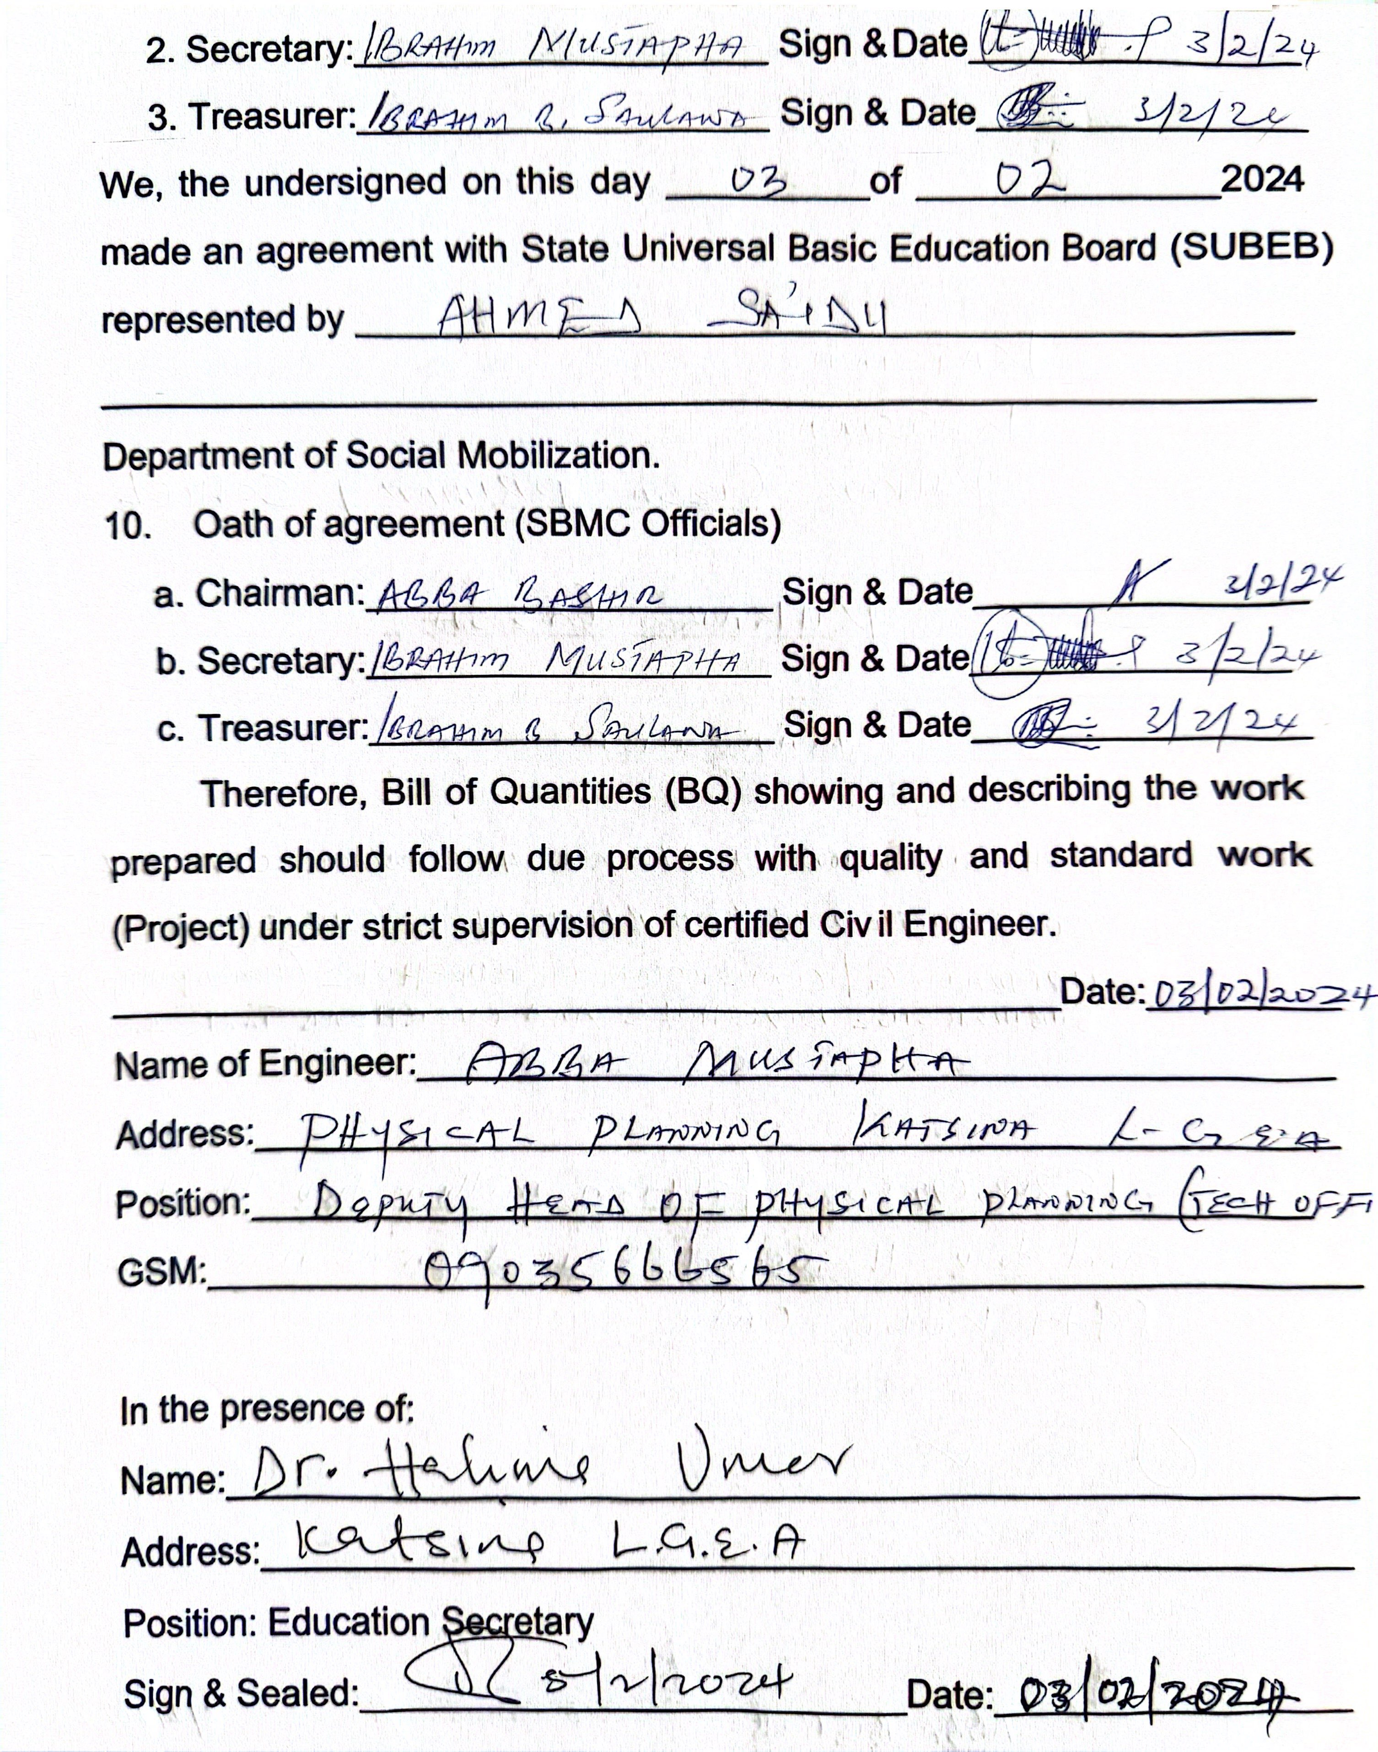
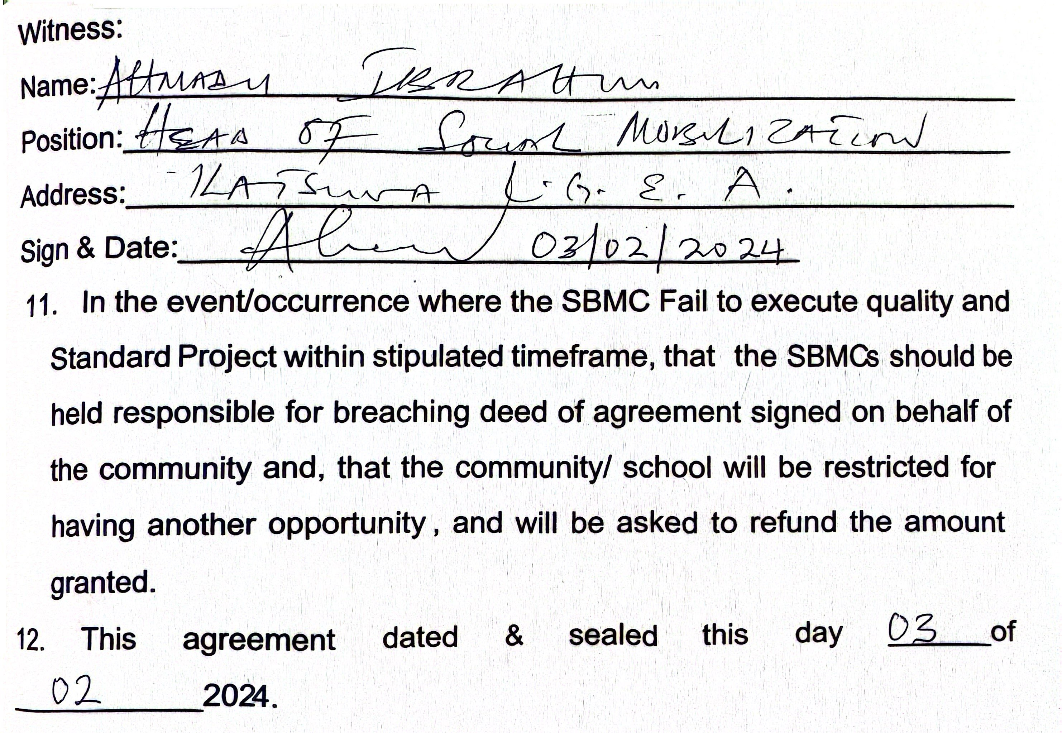
Sample of signed MoU by a one of the beneficiary school

Slide 11
Environmental & social impact site specific screening
Number of schools/SBMCs planned to be included in the different phases.
E&S site screening template/data | Link to Environmental & Social Impact Screening at Project Sites/Schools
Questionnaire | https://enketo.ona.io/x/AyNxuhAR
Photos – Site pictures | https://ona.io/auwal_dqa/224346/785849#/photos
Maps – Site maps | https://ona.io/auwal_dqa/224346/785849#/map
Table – Raw data | https://ona.io/auwal_dqa/224346/785849#/table
Sample of E&S project site screening report:

Slide 12
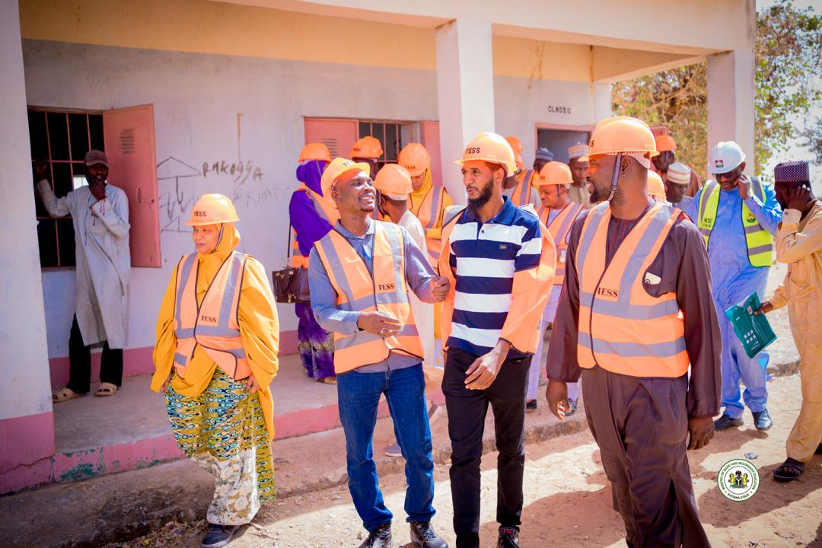
NPCU & State Team Monitoring ongoing SIG Utilization in Shagumba PS, Batagarawa LGA

Slide 13
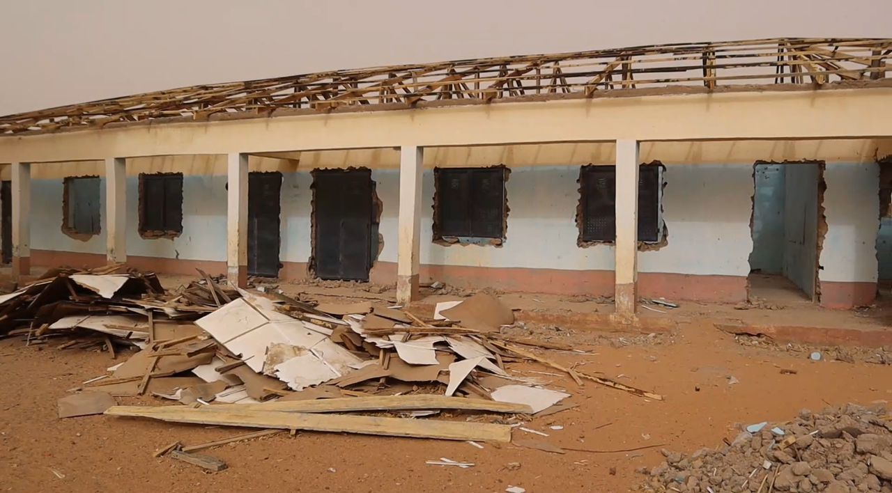
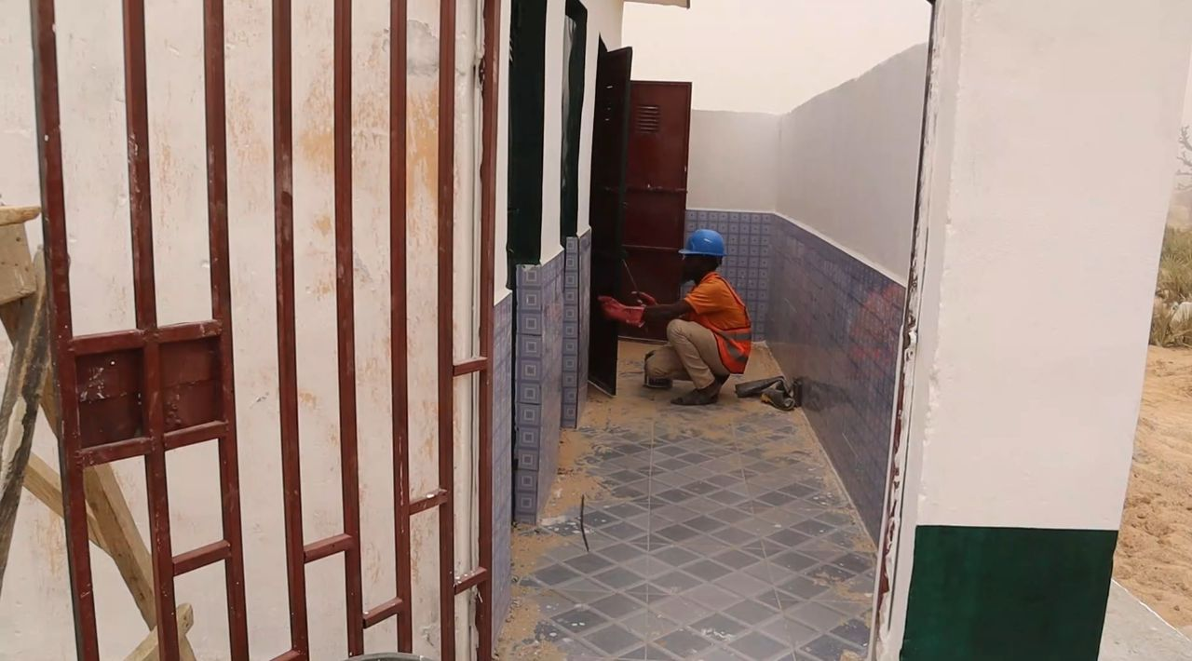
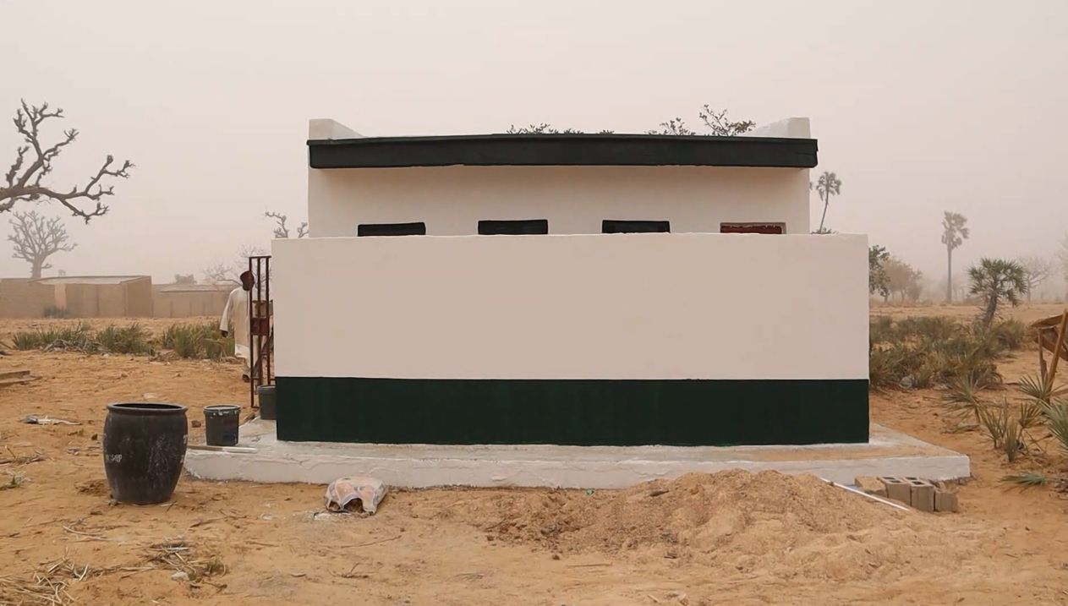
Ongoing school infrastructure improvement work (grant utilization) in some focus schools

Slide 14
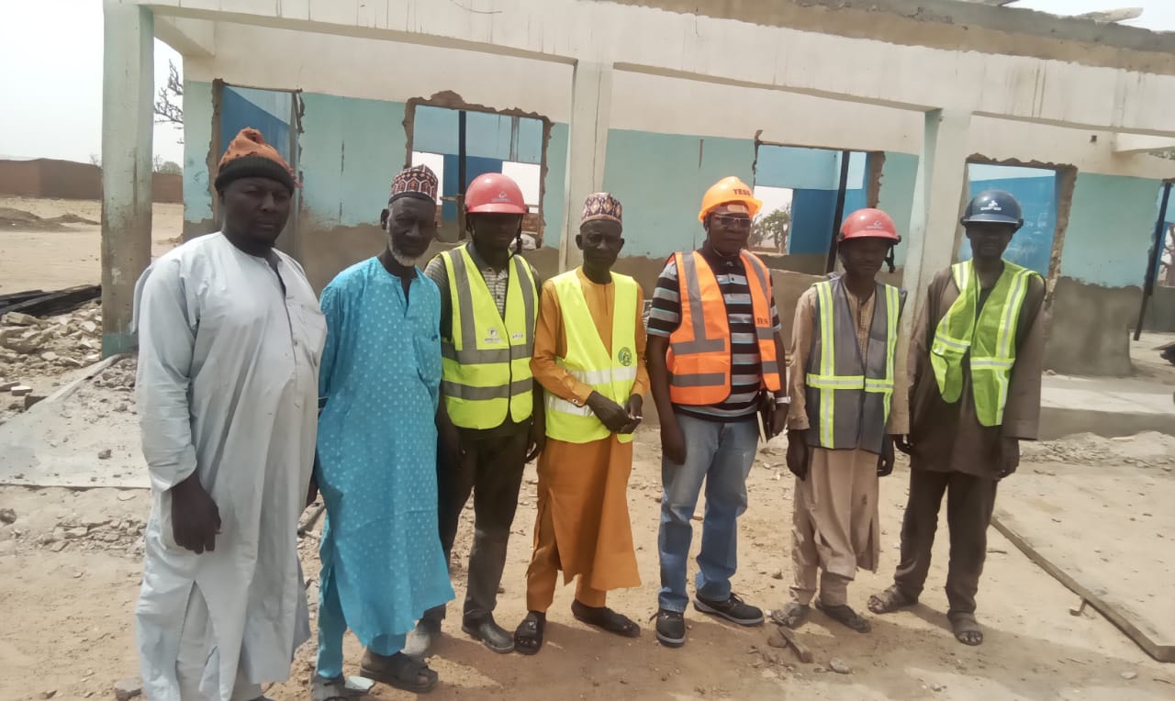
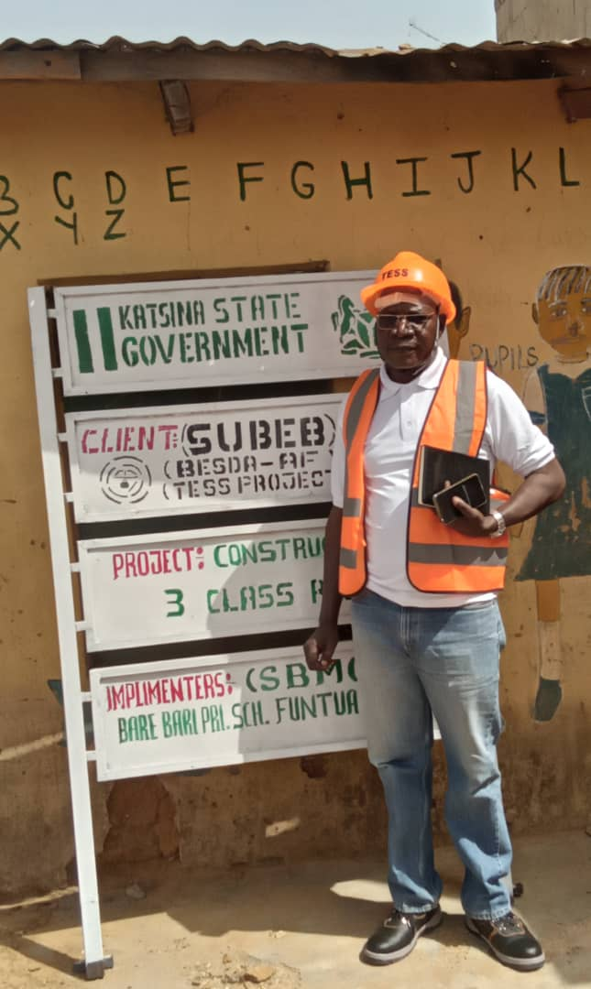
Ongoing site-specific project monitoring by the state monitoring team

Slide 15
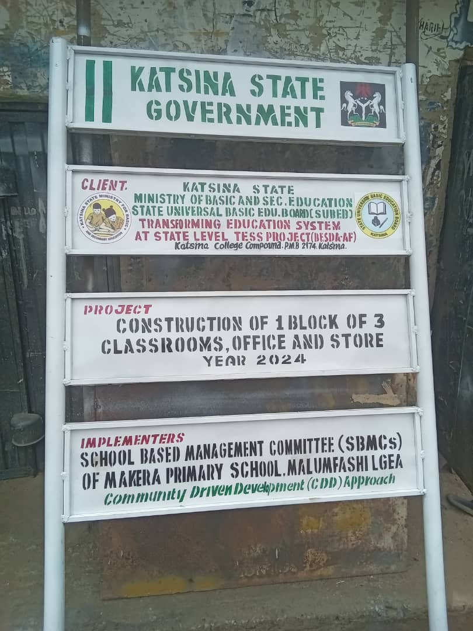
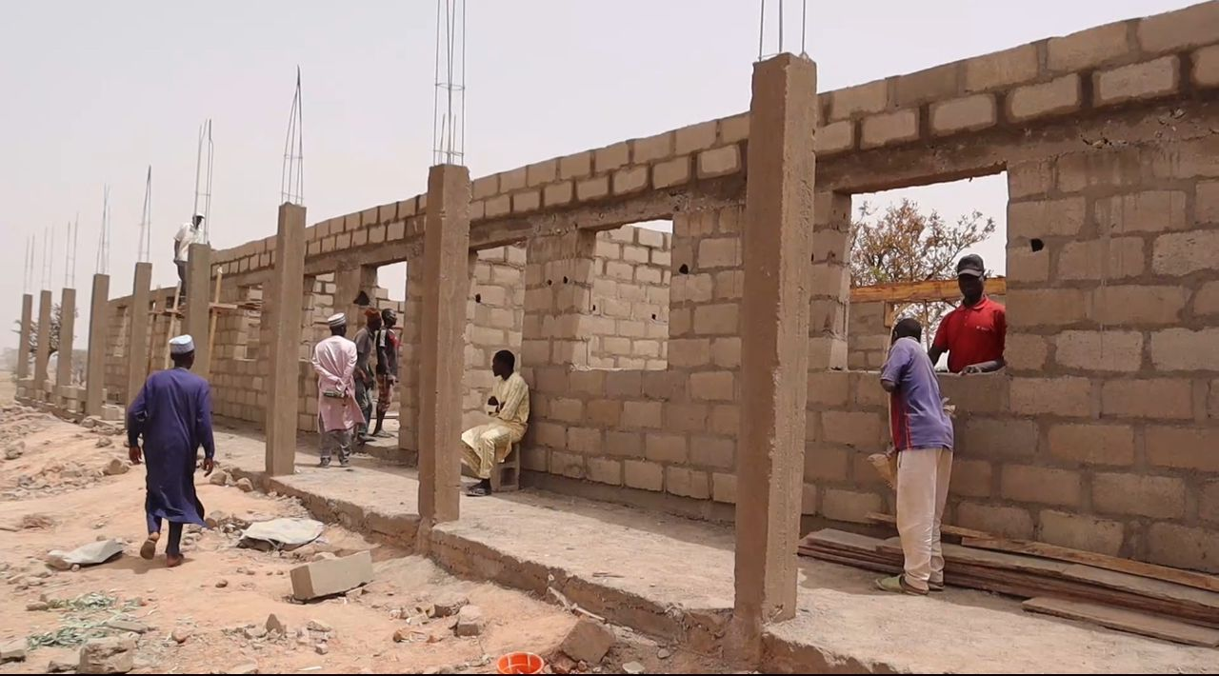
Ongoing construction of additional classrooms, office & store facilitated by sbmc & community driven approach as a result of tess project (gpe-funded besda-af)

Slide 16
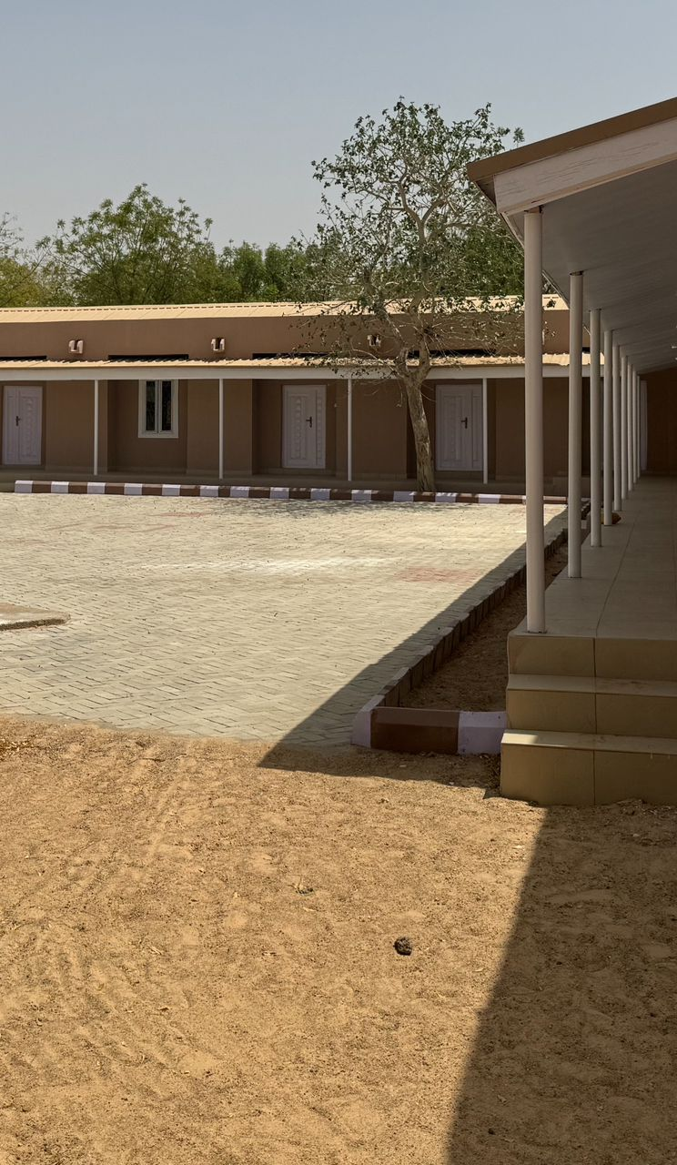
Katsina State TESS Project Implementation Unit (GPE-funded BESDA-AF Project)

